Slide 1

Super Store Analysis
Presented by: DATAVERSE
Date:17/5/2025

Slide 2

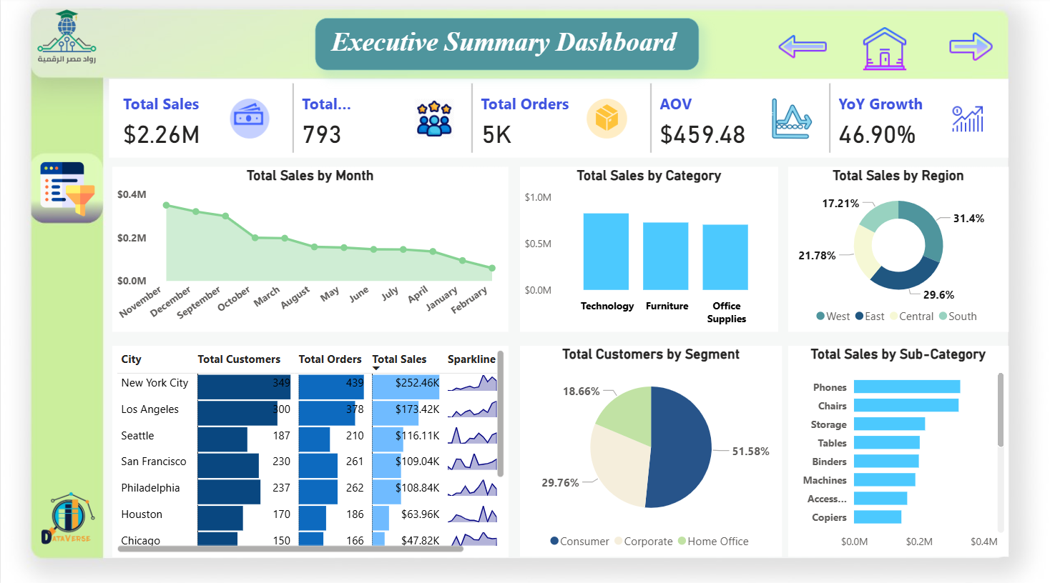
Problem Being Solved Large retail stores often collect thousands of sales records, but without a proper system for visualizing and analyzing them, it's hard to gain insights into customer behavior, product performance, or regional trends
Proposed Solution
We developed an interactive Power BI dashboard using DAX, based on 9,800 sales records across multiple U.S. cities and product categories. The dashboard provides real-time insights into sales performance, customer segments, top-performing products, and regional trend.
Unique Value Proposition
Our dashboard transforms raw transactional data into clear, actionable visuals, empowering decision-makers to quickly understand what drives success and needs attention. It saves time, reduces manual reporting, and enables data-driven decisions.

Slide 3

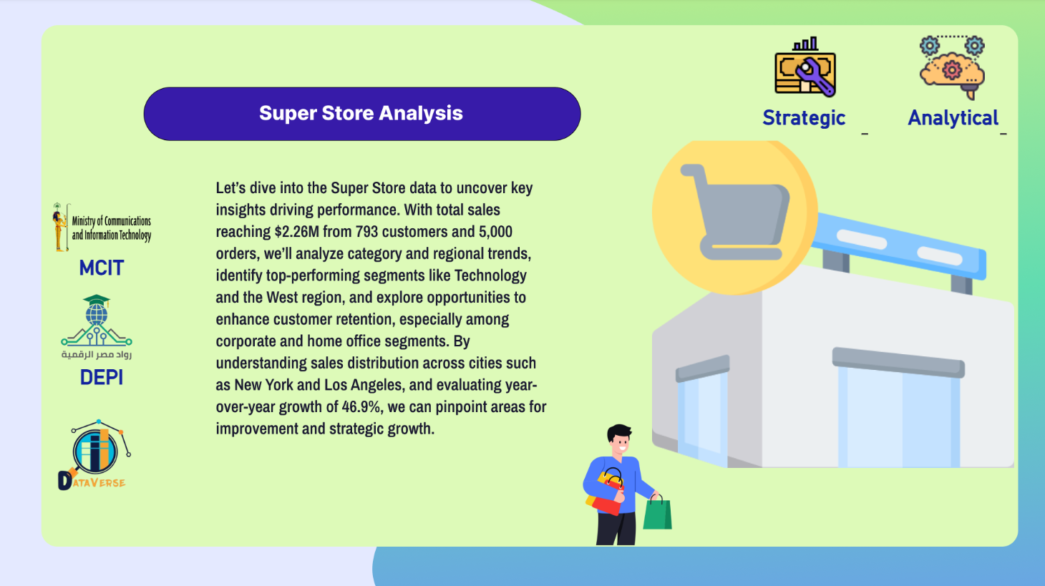
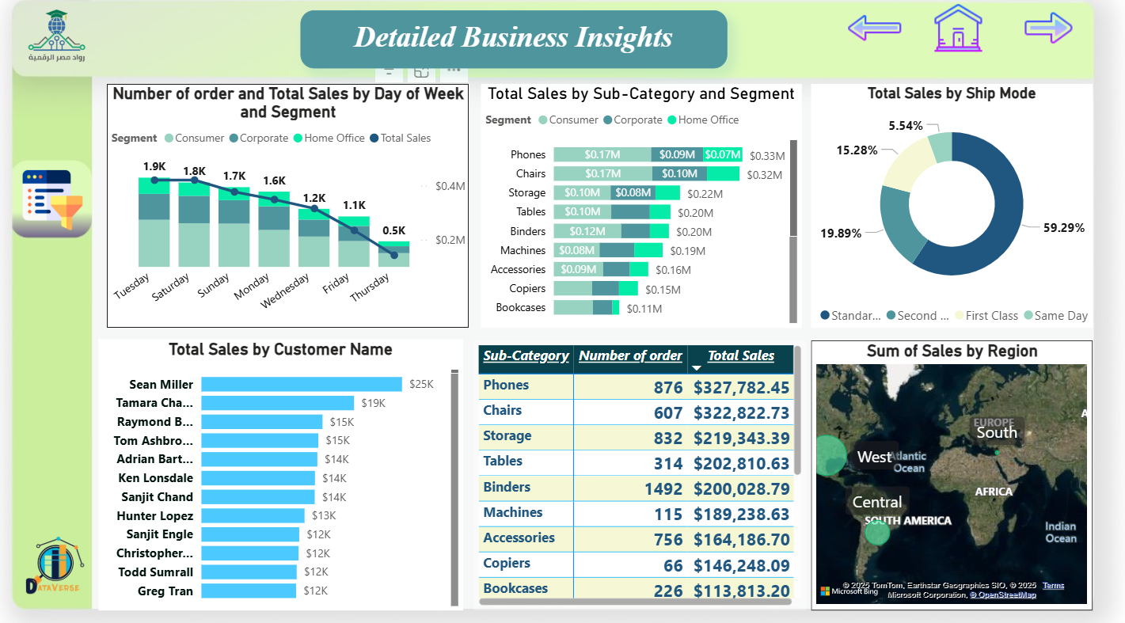
Dashboard Overview
The Power BI dashboard is designed to help retail managers explore key metrics such as:
Total Sales
Sales by Region and State
Top-Selling Products
Customer Segments
Category-wise performance
Users can apply filters (e.g., by region, category, or date) to explore specific areas of interest.
User Journey
Start at the homepage (KPI summary).
Navigate to Sales by Region to compare performance across states.
Dive into Product Categories to identify top and low performers.
Use filters to focus on specific time ranges or customer segments.
Tools Used
Power BI for data visualization.
DAX (Data Analysis Expressions) for dynamic and complex business logic.
Power Query for Data Cleaning

Slide 4


Target Users Store Managers: Need quick insights into overall sales and performance. Sales Teams: Want to track best-selling products and customer trends. Executives: Require summaries and KPIs for decision-making.
Key Features
Interactive KPI cards (Total Sales, Profit, Orders)
Regional sales breakdown (State, City, Region)
Product/category-level analysis
Time-based filters (daily, monthly, yearly)
Customer segmentation insights
How It Solves Their Problems
Helps managers monitor performance instantly.
Enables sales teams to focus on high-performing areas.
Gives executives a clear picture of what’s working and what’s not, in one place.

Slide 5
Data Source & Type
The dataset is in CSV format containing 9,800 rows and 18 columns.
It includes data on orders, customers, products, regions, and sales.
Data Cleaning & Processing
Used Power Query to:
Remove duplicates
Handle missing values
Format date fields
Set correct data types
Key Data Fields
Order Details: Order ID, Order Date, Ship Date, Sales.
Customer Info: Customer ID, Customer Name, Segment.
Location: City, State, Region.
Product: Category, Sub-Category, Product Name
Data Flow
Import CSV file into Power BI
Clean and transform data using Power Query
Model the data (flat table, no complex relationships)
Create DAX measures for key metrics
Build and publish interactive dashboards

Slide 6
Power BI
Tools & Technologies Used
Power BI was used as the main data visualization tool. It allowed us to create an interactive dashboard with visual insights tailored to business needs.
DAX (Data Analysis Expressions) was used to build custom calculations and measures such as total sales, profit, and time-based metrics.
Power Query handled data transformation: cleaning, reshaping, and preparing the dataset for analysis by removing duplicates, formatting columns, and correcting data types
DAX
Power Query

Slide 7

Current Application State
The dashboard is fully functional and finalized using Power BI. It provides interactive insights and has been reviewed for accuracy and usability.
Testing Phases
Data Validation: Cross-checked totals and trends using Excel to ensure accuracy.
DAX Testing: Verified that all measures (Sales, Profit, Orders) return correct and dynamic results.
Dashboard Usability: Tested navigation, slicers, and filters to ensure smooth user experience.

Slide 8

Final Deliverables
Power BI Dashboard File (.pbix) – Complete interactive report with all visualizations and filters.
Project Report (PDF) – Includes problem statement, data description, process steps, and screenshots.
Presentation Slides (PPTX) – Final project presentation.
CSV Dataset – Original dataset used in analysis.
Milestone | Date
Data Cleaning Data Modeling | 19/03/2025 9/04/2025
Dashboard Design | 28/04/2025
Testing & Feedback | 02/05/2025
Final Submission | 08/05/2025
------------------------------------------

Slide 9
Content:
Team Members and Roles:
Ashraf - Data Analyst (Data Cleaning)
Tarek Mostafa - Data Analyst (Data Cleaning)
Mohamed Youssef - Data Modeler (DAX and Modeling)
Antonuois aymen - Data Modeler (DAX and Modeling)
Ashraf Elkhouly - Data Modeler (DAX and Modeling)
Samah Shehata - Dashboard Developer (Dashboard Design)
Key Responsibilities:
Ashraf: Cleaning and preparing raw data to ensure accuracy and consistency for analysis in Power BI.
Tarek Mostafa: Assisting in data cleaning, validating data quality, and preprocessing datasets.
Mohamed Youssef: Developing DAX formulas and creating data models to support analytical queries in Power BI.
Antonuois aymen : Building and optimizing data models, ensuring efficient data relationships in Power BI.
Ashraf Elkhouly: Supporting DAX development and refining data models for enhanced performance.
Samah Shehata: Designing and developing interactive dashboards in Power BI to visualize key insights.
Collaboration Methods
Communication Tools: WhatsApp group for daily updates and quick coordination; Google Meet for weekly team meetings.
Project Management: Trello for task tracking and Agile methodology with bi-weekly sprints.
Data Storage: Shared cloud storage (e.g., OneDrive) for datasets and Power BI files, with version control for dashboards.

Slide 10
Thank You
If you have any questions?
Tarek Mostafa Mohamed
tarekk.mosttafa@gmail.com
Mohamed youssef Mohamed
yoyosakaya1@gmail.com
Antonuois Ayman Siddiq
antonuoisaymen300@gmail.com
Ashraf Fadlallah Saadallah
ashraf.fadlalllah@gmail.com
Ashraf Mawoad Ramadan
ashrfmwdalkhwly@gmail.com
Samah Shehata Abdo Mohamed
samahshehata@std.mans.edu.eg

